Slide 1
Propensity Score Matching
Adrian Matthew G. Glova
Assistant Professor
UP School of Statistics

Slide 2
Primary References
Khandker, S., G. Koolwal, and H. Samad. 2009. Handbook on Impact Evaluation: Quantitative Methods and Practices. Washington, DC: World Bank. https://openknowledge.worldbank.org/bitstream/handle/10986/2693/520990PUB0EPI1101Official0Use0Only1.pdf.
White, H., and D. Raitzer. 2017. Impact Evaluation of Development Interventions: A Practical Guide. Manila, Philippines: Asian Development Bank. https://www.adb.org/sites/default/files/publication/392376/impact-evaluation-development-interventions-guide.pdf
Gertler, Paul J., Sebastian Martinez, Patrick Premand, Laura B. Rawlings, and Christel M. J. Vermeersch. 2016. Impact Evaluation in Practice, second edition. Washington, DC: Inter-American Development Bank and World Bank. https://openknowledge.worldbank.org/server/api/core/bitstreams/4659ef23-61ff-5df7-9b4e-89fda12b074d/content

Slide 3
Overview of Propensity Score Matching
PSM constructs a statistical comparison group based on a probabilistic model for treatment participation
This model is defined over a set of observable characteristics
Participants and non-participants are then matched on the basis of this predicted probability or propensity score
May be one-to-one, one-to-many, or subject to a threshold or rule
PSM is a specific form of “matching”. Variations would involve:
Different criteria to conduct matching (i.e. non-propensity score measures)
Different methods to predict the probability of treatment participation
Different methods to match participants with non-participants
Combination with other impact evaluation methods (e.g. DiD)

Slide 4
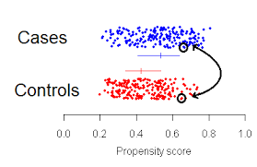
In Propensity Score Matching:
We predict the probability of program participation (i.e. propensity score) for every observation using observable characteristics
We match treatment (T) and control (C) units with similar propensity scores
We obtain the impact estimate by getting the difference in outcomes for the matched T/C units
PSM addresses the curse of dimensionality in exact matching of covariates

Slide 5
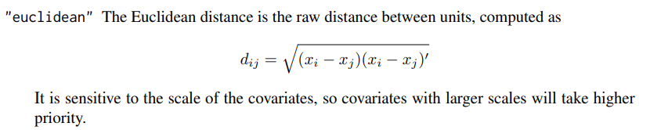
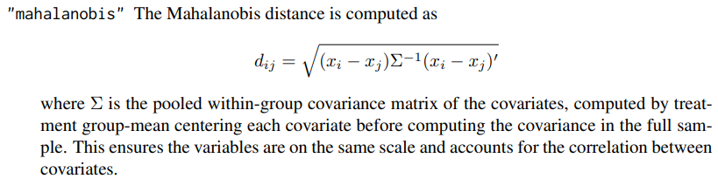
Overview of Propensity Score Matching
Propensity scoring allows us to obtain a large sample size for analysis (i.e. common support region), while maintaining internal validity
Outside of propensity scores, we may match on other measures:
Euclidean, Mahalanobis or other distance measures based on some covariate(s)

Slide 6
Overview of Propensity Score Matching
PSM mimics randomization but only on the set of observable (baseline) characteristics
In randomization, even unobservables (e.g. motivation, risk-aversion, entrepreneurship) are controlled for → gold standard
Each participant is matched with observationally similar non-participant(s). The average difference in outcomes between the two groups is the estimated the impact of treatment
If participation in a program is solely determined by observable characteristics, and if enough non-participants can be matched with participants, then the impact can be reasonably estimated

Slide 7
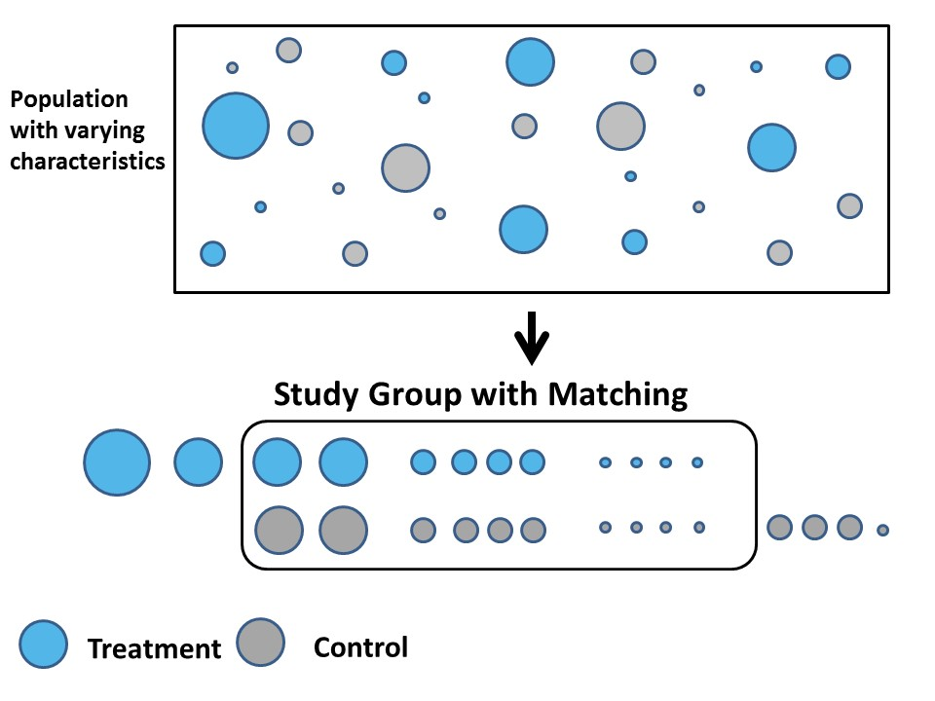
Image Source: https://www.summitllc.us/propensity-score-matching

Slide 8
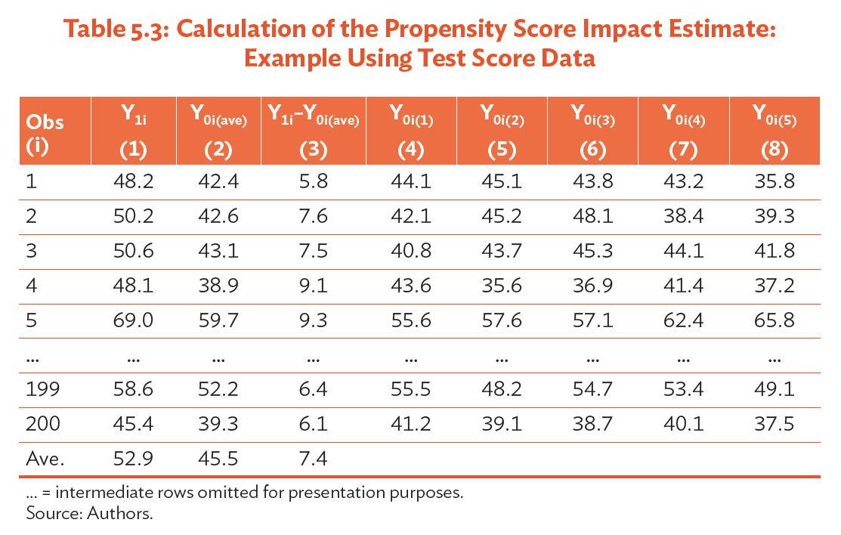
Overview of Propensity Score Matching
Source: White et al. (2017)

Slide 9
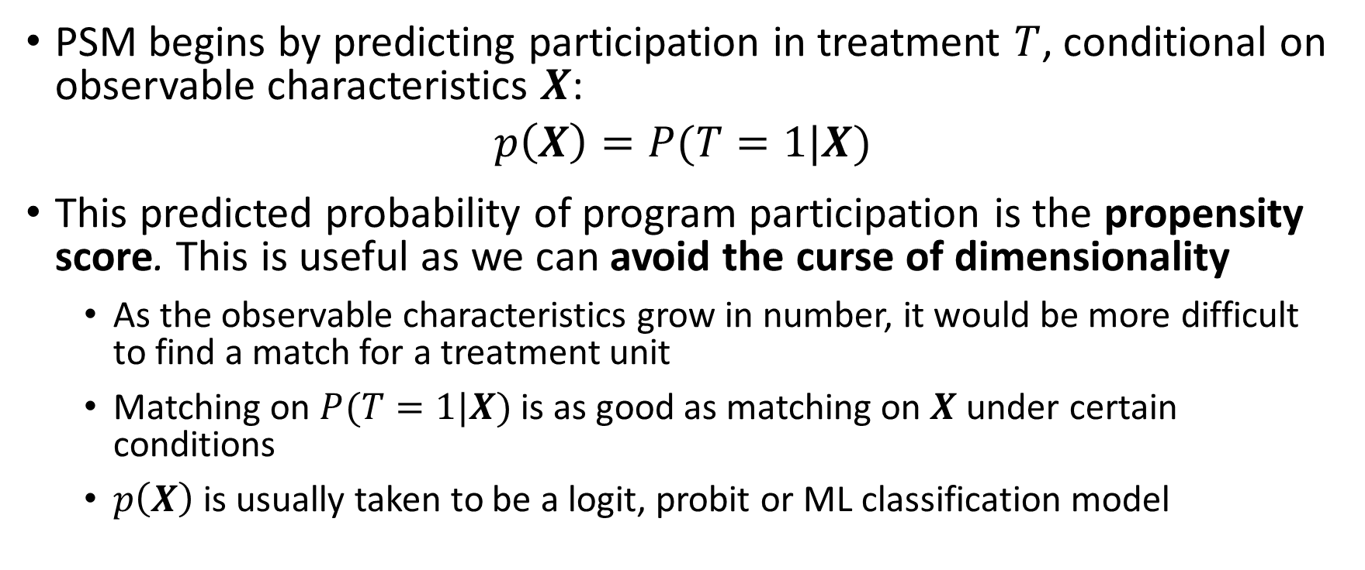
Theory of PSM
PSM begins by predicting participation in treatment $T$, conditional on observable characteristics $X$:
$$p\left(X\right)=P(T=1|X)$$
This predicted probability of program participation is the propensity score. This is useful as we can avoid the curse of dimensionality
As the observable characteristics grow in number, it would be more difficult to find a match for a treatment unit
Matching on $P(T=1|X)$ is as good as matching on $X$ under certain conditions
$p\left(X\right)$ is usually taken to be a logit, probit or ML classification model

Slide 10
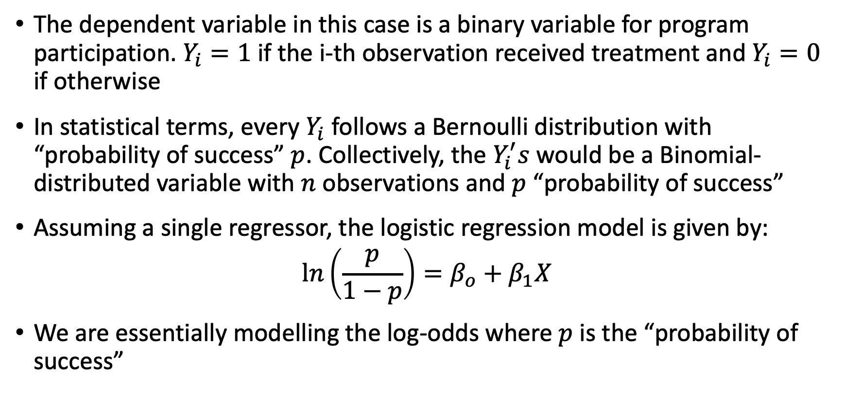
Logistic Regression
The dependent variable in this case is a binary variable for program participation. $Y_{i}=1$ if the i-th observation received treatment and $Y_{i}=0$ if otherwise
In statistical terms, every $Y_{i}$follows a Bernoulli distribution with “probability of success” $p$. Collectively, the $Y_{i}^{′}s$ would be a Binomial-distributed variable with $n$ observations and $p$ “probability of success”
Assuming a single regressor, the logistic regression model is given by:
$$\ln\left(\frac{p}{1−p}\right)=β_{o}+β_{1}X$$
We are essentially modelling the log-odds where $p$ is the “probability of success”

Slide 11
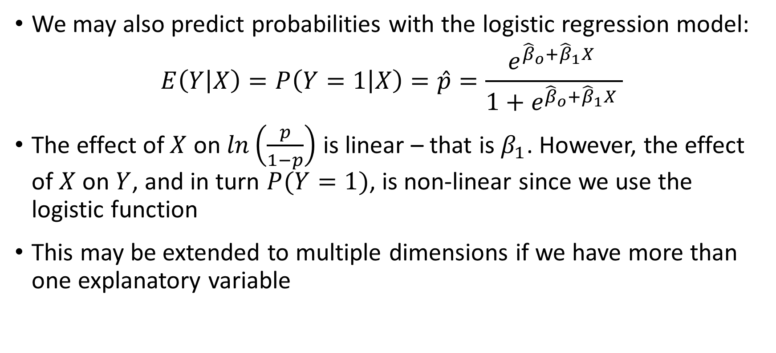
Logistic Regression
We may also predict probabilities with the logistic regression model:
$$E\left(Y | X\right)=P\left(Y=1 | X\right)=\hat{p}=\frac{e^{{\hat{β}}_{o}+{\hat{β}}_{1}X }}{1+e^{{\hat{β}}_{o}+{\hat{β}}_{1}X }}$$
The effect of $X$ on $\ln\left(\frac{p}{1−p}\right)$ is linear – that is $β_{1}$. However, the effect of $X$ on $Y$, and in turn $P(Y=1)$, is non-linear since we use the logistic function
This may be extended to multiple dimensions if we have more than one explanatory variable

Slide 12
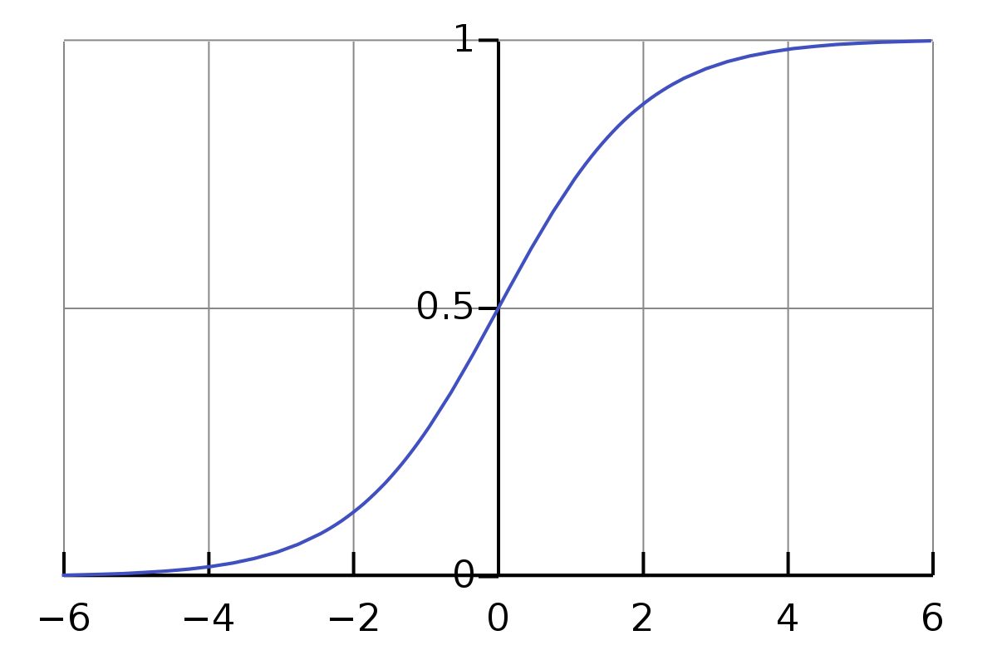

Graph of $y =\frac{e^{x}}{1+e^{x}}$ (Sigmoid or Logistic Curve)

Slide 13
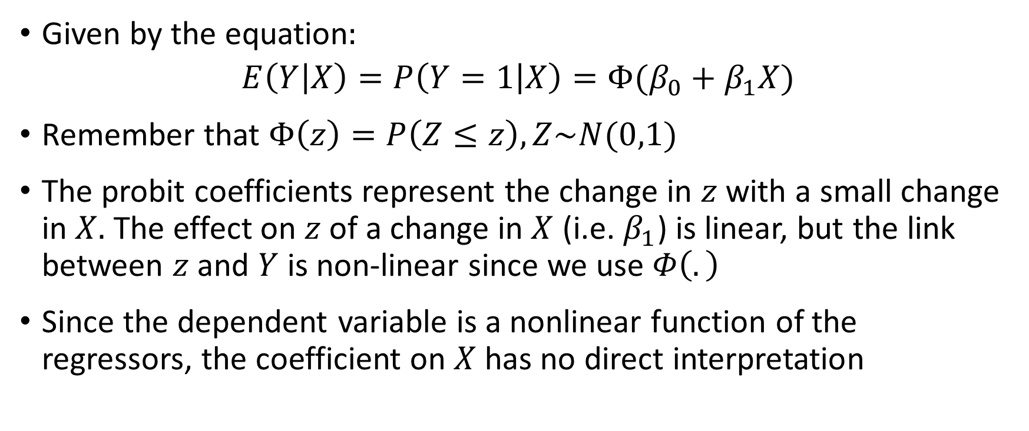
Probit Regression
Given by the equation:
$$E\left(Y | X\right)=P\left(Y=1 | X\right)=Φ(β_{0}+β_{1}X)$$
Remember that $Φ\left(z\right)=P\left(Z≤z\right), Z\sim N(0,1)$
The probit coefficients represent the change in $z$ with a small change in $X.$ The effect on $z$ of a change in $X$ (i.e. $β_{1}$) is linear, but the link between $z$ and $Y$ is non-linear since we use $Φ\left(.\right)$
Since the dependent variable is a nonlinear function of the regressors, the coefficient on $X$has no direct interpretation

Slide 14
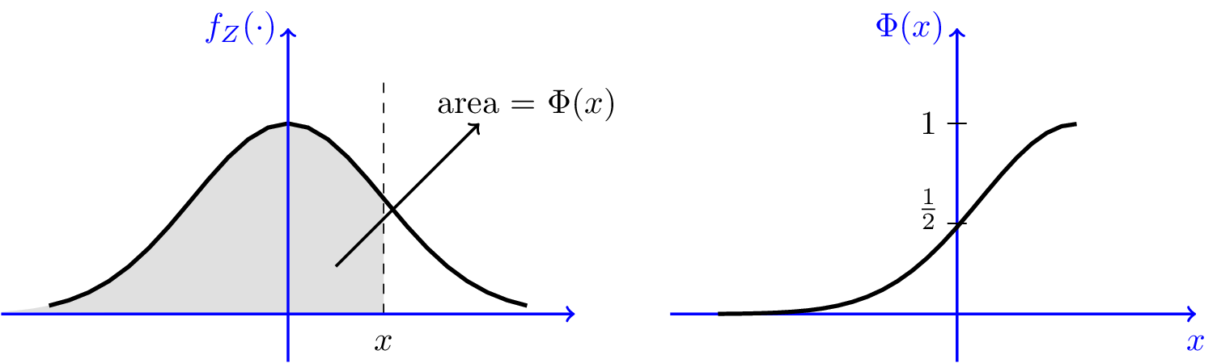
CDF of Standard Normal

Slide 15
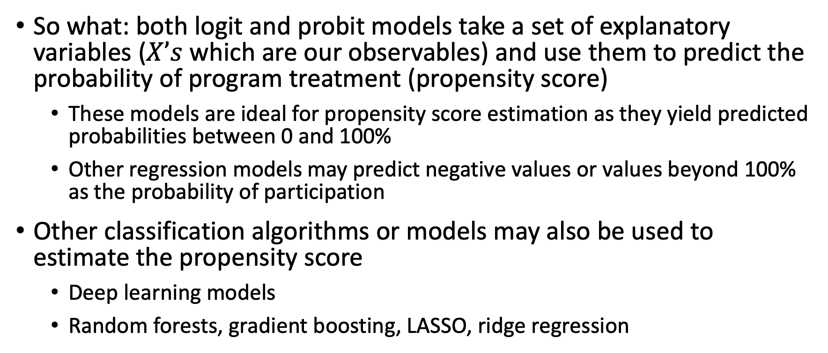
Theory of PSM
So what: both logit and probit models take a set of explanatory variables ($X’s$ which are our observables) and use them to predict the probability of program treatment (propensity score)
These models are ideal for propensity score estimation as they yield predicted probabilities between 0 and 100%
Other regression models may predict negative values or values beyond 100% as the probability of participation
Other classification algorithms or models may also be used to estimate the propensity score
Deep learning models
Random forests, gradient boosting, LASSO, ridge regression

Slide 16
Theory of PSM
Outcomes for participating and non-participating units with similar propensity scores are compared to obtain the treatment effect
Treatment units for which no match can be found (i.e. no counterfactual) are dropped as they may skew estimated treatment effects
Matching algorithms may include: Nearest neighbor, N-nearest neighbor, radius matching, stratification or interval matching, local linear matching
Sanity check: compare results with different matching algorithms
Matching dictates the estimated counterfactual for each treatment unit

Slide 17
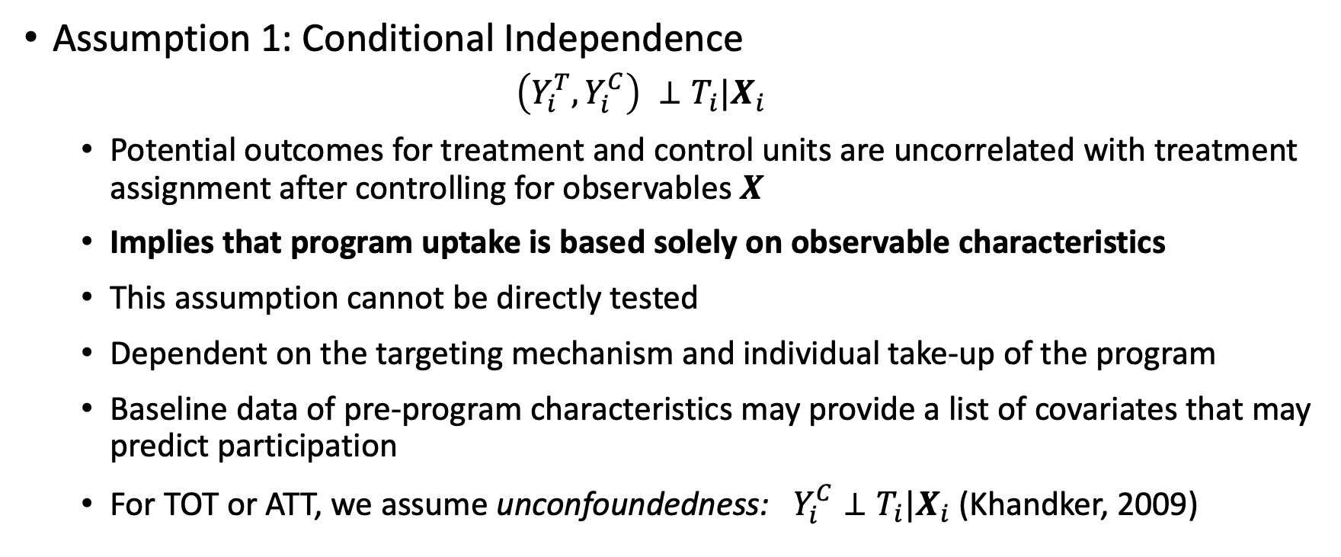
Theory of PSM
Assumption 1: Conditional Independence
$$\left(Y_{i}^{T},Y_{i}^{C}\right) ⊥T_{i}|X_{i}$$
Potential outcomes for treatment and control units are uncorrelated with treatment assignment after controlling for observables $X$
Implies that program uptake is based solely on observable characteristics
This assumption cannot be directly tested
Dependent on the targeting mechanism and individual take-up of the program
Baseline data of pre-program characteristics may provide a list of covariates that may predict participation
For TOT or ATT, we assume unconfoundedness: $Y_{i}^{C}⊥T_{i}|X_{i}$ (Khandker, 2009)

Slide 18
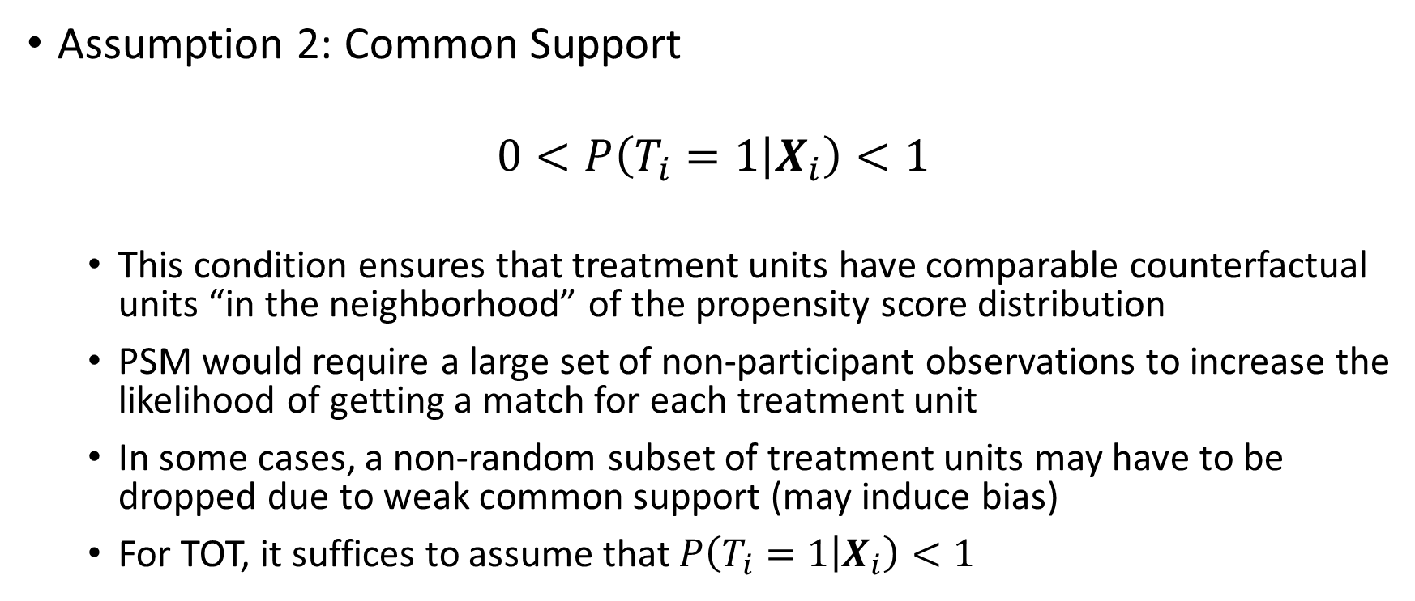
Theory of PSM
Assumption 2: Common Support
$$0<P\left(T_{i}=1 | X_{i}\right)<1$$
This condition ensures that treatment units have comparable counterfactual units “in the neighborhood” of the propensity score distribution
PSM would require a large set of non-participant observations to increase the likelihood of getting a match for each treatment unit
In some cases, a non-random subset of treatment units may have to be dropped due to weak common support (may induce bias)
For TOT, it suffices to assume that $P\left(T_{i}=1 | X_{i}\right)<1$

Slide 19
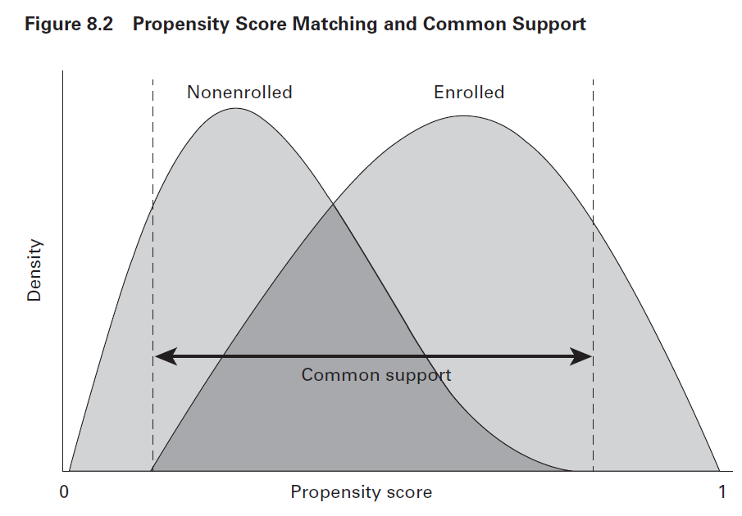
Region of Common Support
Source: Gertler et al. (2016)

Slide 20
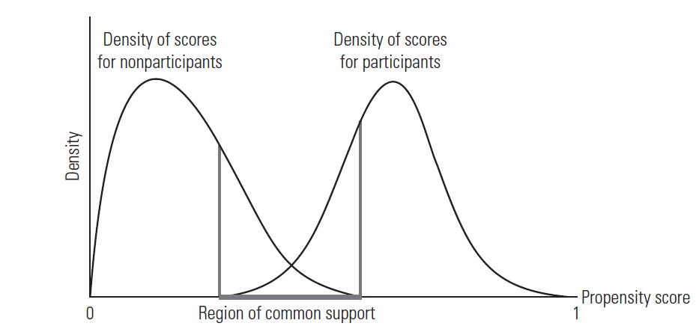
Region of Common Support
Source: Khandker et al. (2009)

Slide 21
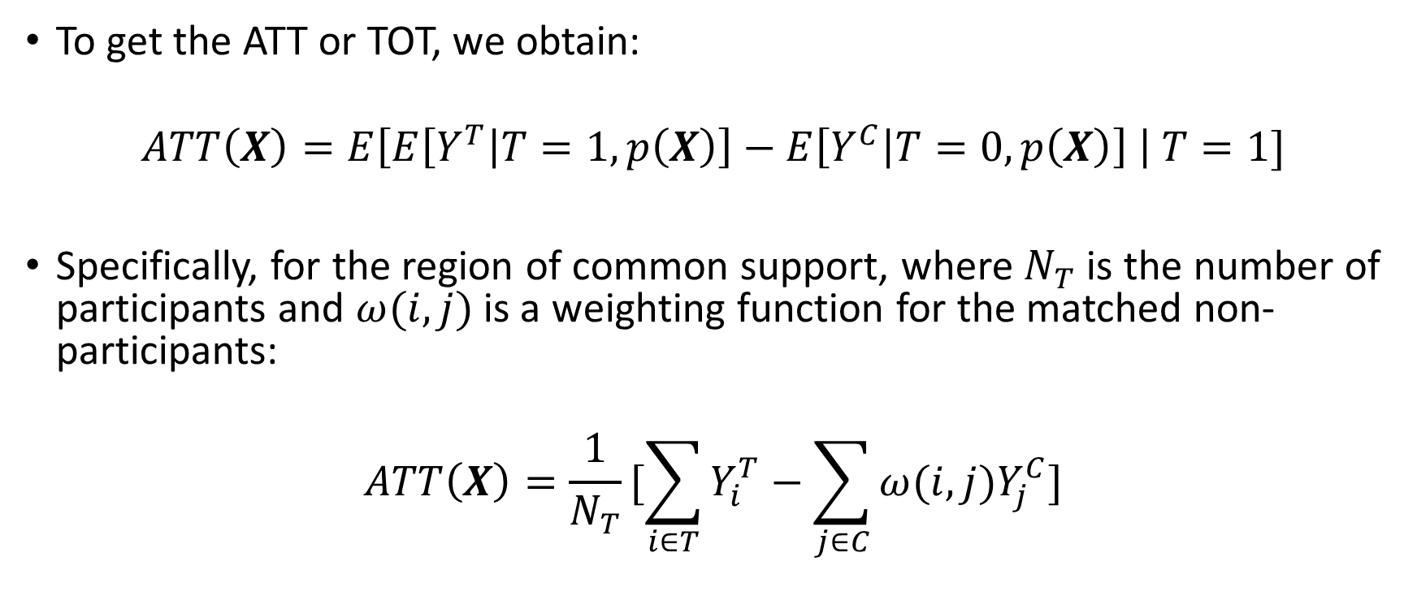
Treatment Effect of PSM
To get the ATT or TOT, we obtain:
$$ATT\left(X\right)=E\left[E\left[Y^{T} | T=1,p\left(X\right)\right]−E\left[Y^{C} | T=0,p\left(X\right)\right] \right| T=1]$$
Specifically, for the region of common support, where $N_{T}$is the number of participants and $ω(i,j)$is a weighting function for the matched non-participants:
$$ATT\left(X\right)=\frac{1}{N_{T}}[\sum_{i∈T}{Y_{i}^{T}}−\sum_{j∈C}{ω(i,j)Y_{j}^{C}}]$$

Slide 22
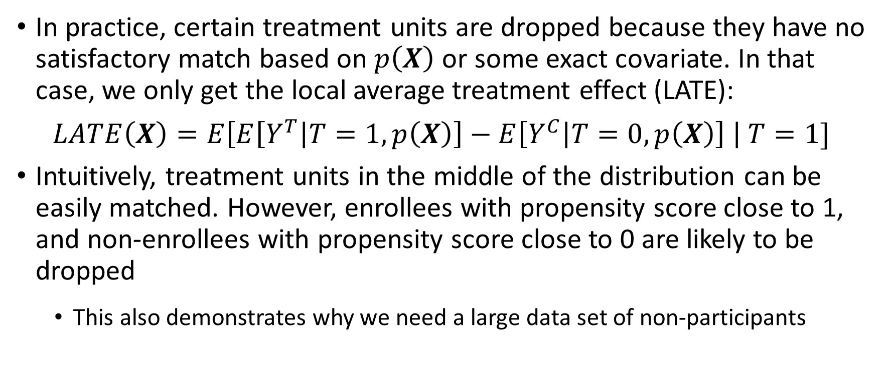
Treatment Effect of PSM
In practice, certain treatment units are dropped because they have no satisfactory match based on $p\left(X\right)$ or some exact covariate. In that case, we only get the local average treatment effect (LATE):
$$LATE\left(X\right)=E\left[E\left[Y^{T} | T=1,p\left(X\right)\right]−E\left[Y^{C} | T=0,p\left(X\right)\right] \right| T=1]$$
Intuitively, treatment units in the middle of the distribution can be easily matched. However, enrollees with propensity score close to 1, and non-enrollees with propensity score close to 0 are likely to be dropped
This also demonstrates why we need a large data set of non-participants

Slide 23
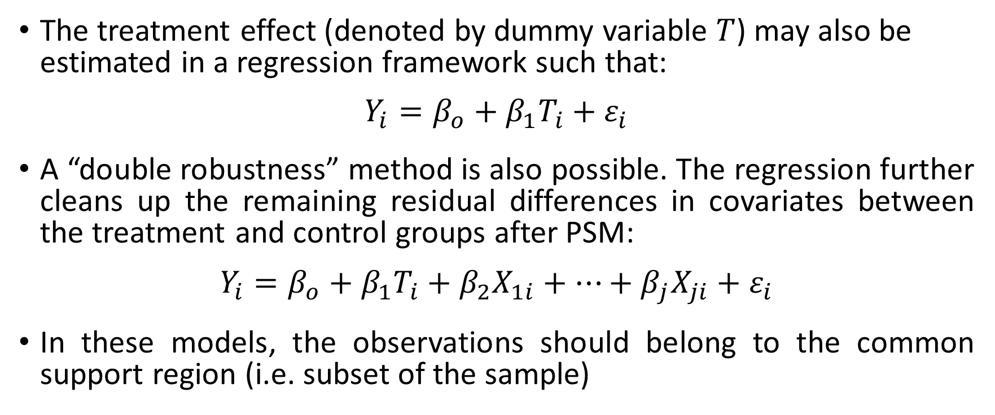
Treatment Effect of PSM
The treatment effect (denoted by dummy variable $T$) may also be estimated in a regression framework such that:
$$Y_{i}=β_{o}+β_{1}T_{i}+ε_{i}$$
A “double robustness” method is also possible. The regression further cleans up the remaining residual differences in covariates between the treatment and control groups after PSM:
$$Y_{i}=β_{o}+β_{1}T_{i}+β_{2}X_{1i}+…+β_{j}X_{ji}+ε_{i}$$
In these models, the observations should belong to the common support region (i.e. subset of the sample)

Slide 24
Note on Standard Errors
Variability in PSM would arise from: (i) the derivation of the propensity score, (ii) the determination of common support, and (iii) the order in which observations are matched, especially if NN-1 is used
Hence, robust standard errors are required (e.g. clustered, bootstrapped, Abadie-Imbens standard errors) and we cannot rely on the standard errors produced in an OLS regression
We’ll see this later in our R codes session

Slide 25
PSM Application
Step 0: Obtain a representative sample for participating and non-participating units using random sampling
Random sampling will ensure that our samples are representative of the population (external validity)
Common sampling schemes would include simple random sampling, stratified sampling, cluster sampling, and systematic sampling

Slide 26
PSM Application
Best practices to aid PSM at the data collection stage include:
Getting a random sample for participants and non-participants that will represent the treatment and comparison groups
Baseline data to get covariates which are not affected by treatment
Baseline data will ensure a rich set of covariates that may determine participation
Using the same survey instrument for participants and non-participants
Obtaining a large sample of non-participants, to avoid dropping participant observations without matches
Participants and non-participants surveyed may be from the same area, so they face similar incentives that drive program participation (i.e. reducing disparities in unobservables)

Slide 27
PSM Application
Step 1: Estimate the propensity score of participants and non-participants (pooled data) based on observable characteristics that may determine participation
The default model for propensity score is usually logistic regression
The set of regressors (e.g. age, pre-program income, sex, household-level characteristics, state-level characteristics) that may predict participation should be based on contextual information and program design
The observable characteristics should predict program participation but not be affected by participation
Counterfactual: same characteristics except treatment received. If observables are affected by treatment, then this is violated
Comparing results with different classification models can be a robustness check

Slide 28
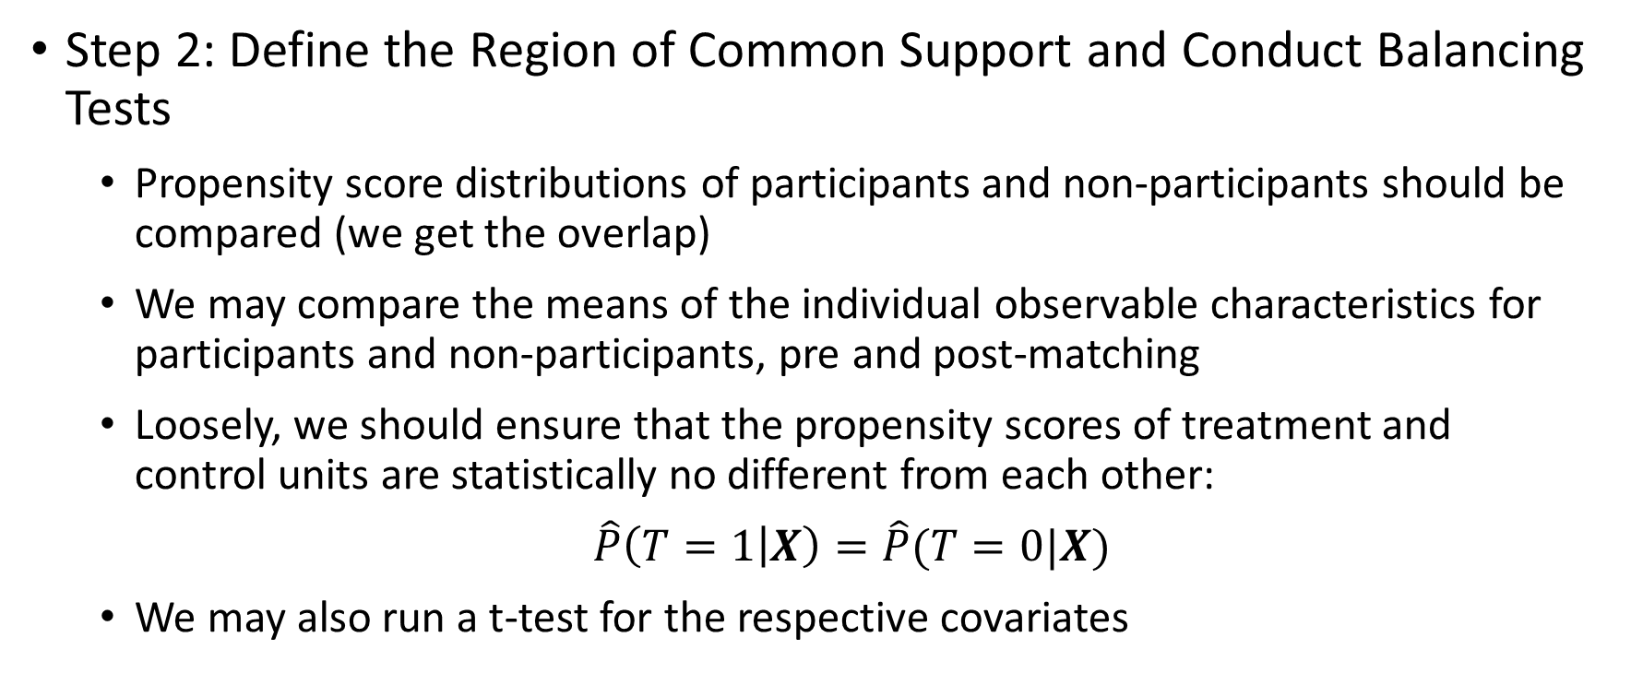
PSM Application
Step 2: Define the Region of Common Support and Conduct Balancing Tests
Propensity score distributions of participants and non-participants should be compared (we get the overlap)
We may compare the means of the individual observable characteristics for participants and non-participants, pre and post-matching
Loosely, we should ensure that the propensity scores of treatment and control units are statistically no different from each other:
$\hat{P}\left(T=1 | X\right)=\hat{P}(T=0|X)$
We may also run a t-test for the respective covariates

Slide 29
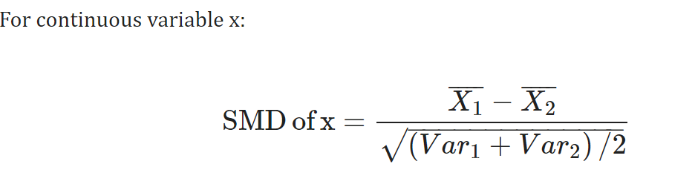
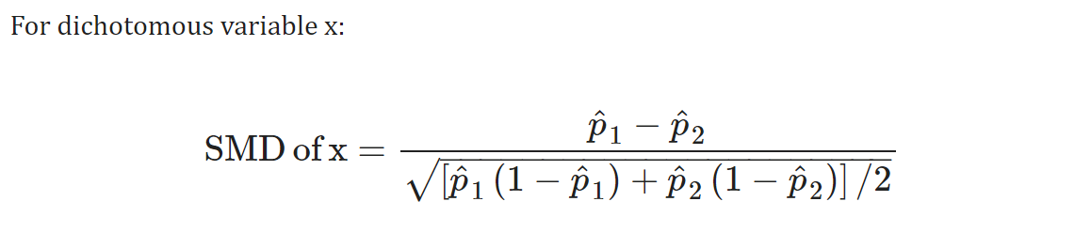
Balance Diagnostics (aside from Paired T-Test)

Slide 30
PSM Application
Step 3: Match Participants to Nonparticipants
Matching can be done with or without replacement. With replacement means a non-participant may be a match to multiple participants
Nearest-neighbor matching: each treatment unit is matched to the comparison unit with the closest propensity score. N-nearest-neighbors is also possible (standard is 5) so that the nearest n neighbors are averaged, which then serves as the match of the treatment unit
Radius matching: a threshold on the propensity score distance is set, then matching is done within this range. There’s a chance for more treatment units to be dropped in this algorithm, but “closer matches” are ensured

Slide 31
PSM Application
Step 3: Match Participants to Nonparticipants
Stratification or interval matching: The region of common support is divided into non-overlapping strata or intervals, and treatment impact is estimated in each stratum. The total treatment effect is then a weighted average (based on number of participants per stratum) of the impact for all strata
Non-parametric matching: The counterfactual for each treatment unit is taken to be a weighted average of all non-participants (or some non-participants in a given neighborhood). The weights are greater when the propensity score is closer to that of the treatment unit
Comparing covariate balance with different matching algorithms is a robustness check

Slide 32
PSM Application
Step 4: Calculate the average treatment impact
If conditional independence and a sizable region of common support are established, then we can calculate the treatment effect
The PSM treatment effect is the mean difference in outcomes (between treatment and control groups) over the common support
Weighted estimates are possible, with the inverse of propensity score estimates serving as weights
Variability in this method would arise from the derivation of the propensity score, the determination of common support, and the order in which observations are matched. Hence, robust standard errors are required

Slide 33
PSM Application
What if covariates do not balance after matching?
Option 1: Re-specify the model used to estimate propensity score by adding more observable characteristics, higher-order terms or interaction terms
Option 2: Using another model to estimate the propensity score (e.g. use probit instead of logit; or use a different classification model)
Option 3: Change the matching method. Perhaps a tighter caliper can be specified, or replacement may be allowed, or allow for one-to-many matching. Note that this may reduce to some treatment units being dropped

Slide 34
PSM Application
What if covariates do not balance after matching?
Option 4: Exact matching on certain covariates may be explored. This way, you first ensure that treatment and control units are equal on certain categories before matching on the propensity score
Option 5: Increase the sample size of control units to for larger common support
A combination of the following is often done

Slide 35
PSM Application
Sanity checks include:
Show different balance diagnostics to show treatment units and control units were adequately matched (paired t-test if NN-1, standardized difference of means, etc.)
Comparing results of estimated impact with (i) different models for propensity score, and (ii) different matching algorithms
Comparing PSM results with other impact evaluation methods, if available (e.g. DiD, multivariate regression model with control variables and a dummy variable for treatment)

Slide 36
PSM Strengths and Weaknesses
Strengths | Weaknesses
Minimal functional form and error term assumptions versus multivariate regression (semi-parametric) | Strong assumption of Conditional Independence (no unobservables driving program participation)
May be used when treatment assignment rules are not clear (e.g. not based on explicit randomization or some eligibility index) | Requires large common support (i.e. large set of non-participant data)

Slide 37
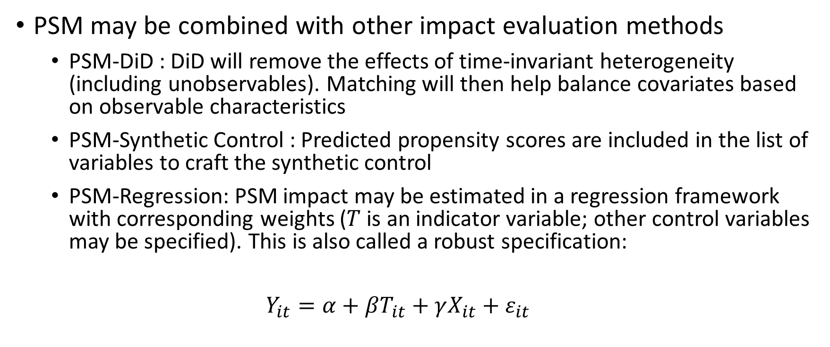
PSM Extensions
PSM may be combined with other impact evaluation methods
PSM-DiD : DiD will remove the effects of time-invariant heterogeneity (including unobservables). Matching will then help balance covariates based on observable characteristics
PSM-Synthetic Control : Predicted propensity scores are included in the list of variables to craft the synthetic control
PSM-Regression: PSM impact may be estimated in a regression framework with corresponding weights ($T$ is an indicator variable; other control variables may be specified). This is also called a robust specification:
$$Y_{it}=α+βT_{it}+γX_{it}+ε_{it}$$

Slide 38
Case Study: Water, sanitation, and hygiene for child health
Capuno, Tan, and Javier (2016)

Slide 39
Motivation of the Study
According to the WHO, diarrheal disease accounts for about 760,000 deaths in children under five, making it the second leading cause of child mortality
Locally, diarrheal diseases are among the top ten causes of infant mortality each year during the period 1995 to 2010
Water, sanitation, and hygiene interventions (i.e. increasing access to safe drinking water and sanitation facilities) break the fecal-oral transmission of bacteria, averting some of these deaths
The paper investigates whether the government’s efforts to sustain household access to safe water and sanitation facilities has translated to improved child health outcomes

Slide 40
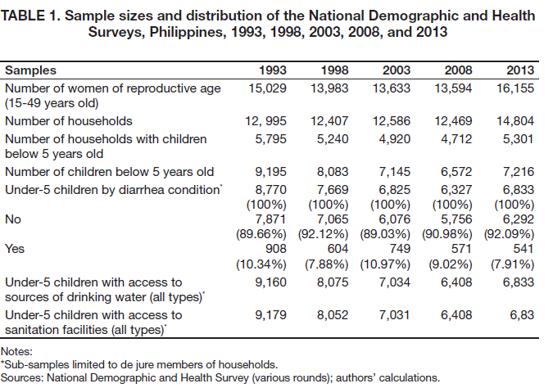
Data (Think Type I and Type II Errors)

Slide 41
Methodology
PSM is applied to obtain the ATT/TOT
Note that the authors have two impact horizons: 1993 to 2008, and 2013
We might be interested in the more recent effects of treatment on outcomes
Step 0: pooled household samples from nationwide surveys undertaken in 1993, 1998, 2003, 2008 and 2013 were obtained
Step 1: Treatment is taken to be access to safe drinking water, and access to sanitation facilities. A logistic regression model is used to predict propensity scores for children below 5 years old
Parental preferences
Individual, household-level, and community-level characteristics

Slide 42
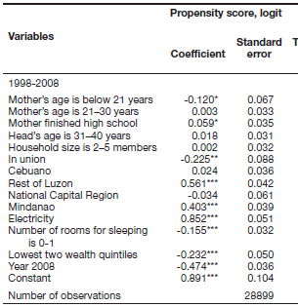
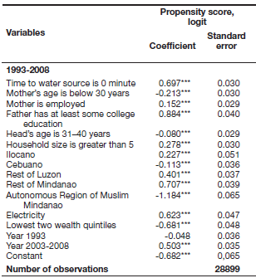
Propensity Score Model
Access to Safe Water Sources
Access to Sanitation Facilities

Slide 43
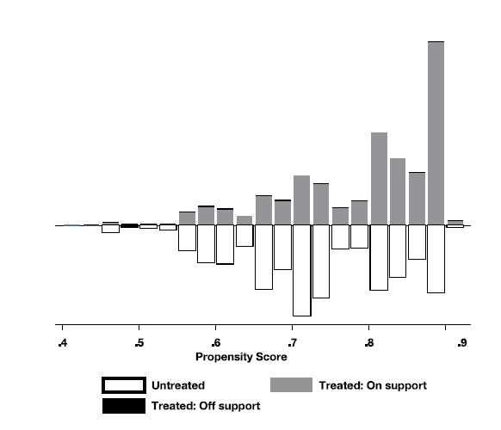
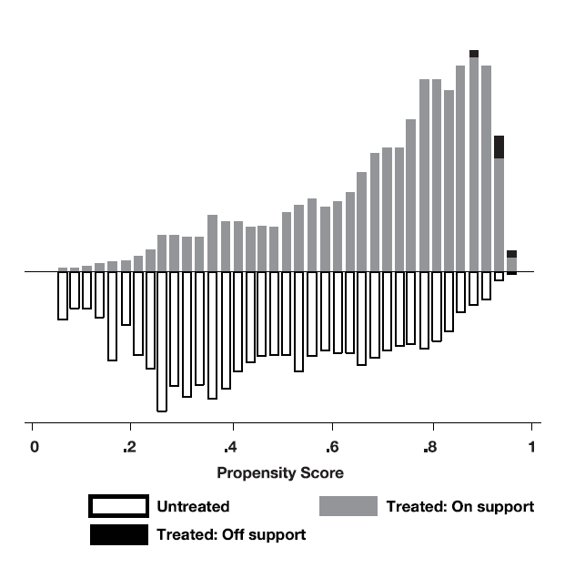
Methodology
Step 2: Region of Common Support and Balancing Tests are Checked
Access to Safe Water Sources
Access to Sanitation Facilities

Slide 44
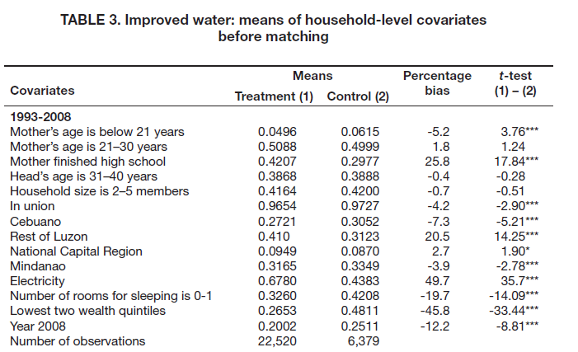
Predictors of Program Participation

Slide 45
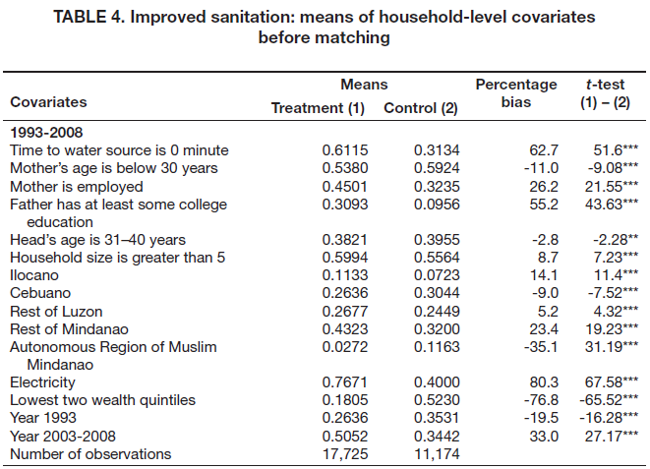
Predictors of Program Participation

Slide 46

Methodology
Step 3: Match Participants to Nonparticipants (and Check Balance post-Matching)

Slide 47
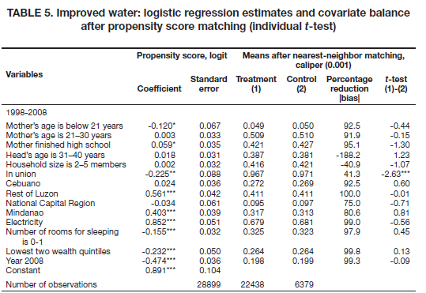

Slide 48
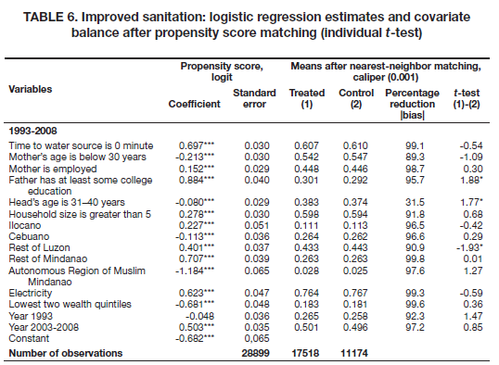

Slide 49
Question: Can we used paired t-test if we do one-to-many matching?

Slide 50

Methodology
Step 4: Calculate the average treatment impact
Impact of PSM with NN-1 matching is estimated

Slide 51
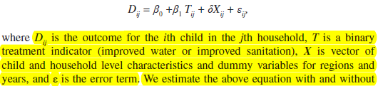
Methodology
Step 4: Calculate the average treatment impact
Linear Probability Model to benchmark PSM impact estimates:

Slide 52
Results (in English)
We find that improved water and improved sanitation each reduced the probability of child diarrhea in 1993-2008 by around two percentage points
In 2013, improved water reduced the probability by about 7 percentage points. On the other hand, improved sanitation does not seem to have a statistically significant effect
The results lend support to the government’s programs to widen access to safe water and sanitation facilities as measures to improve child health

Slide 53
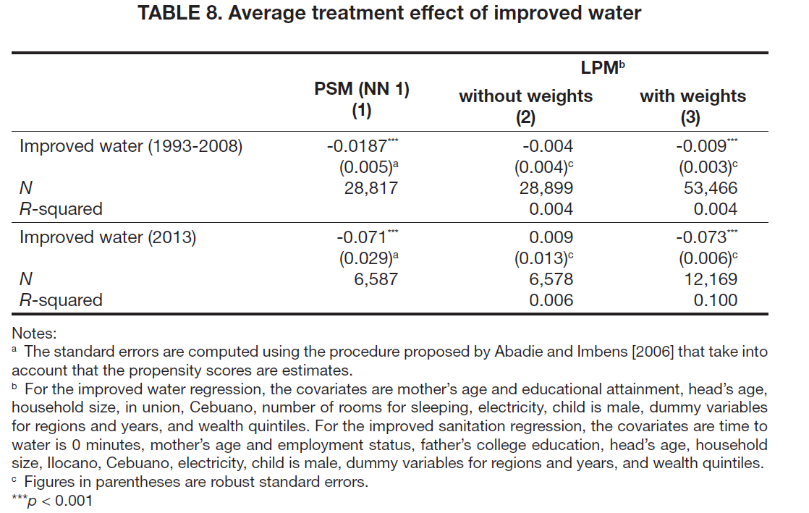
Results

Slide 54
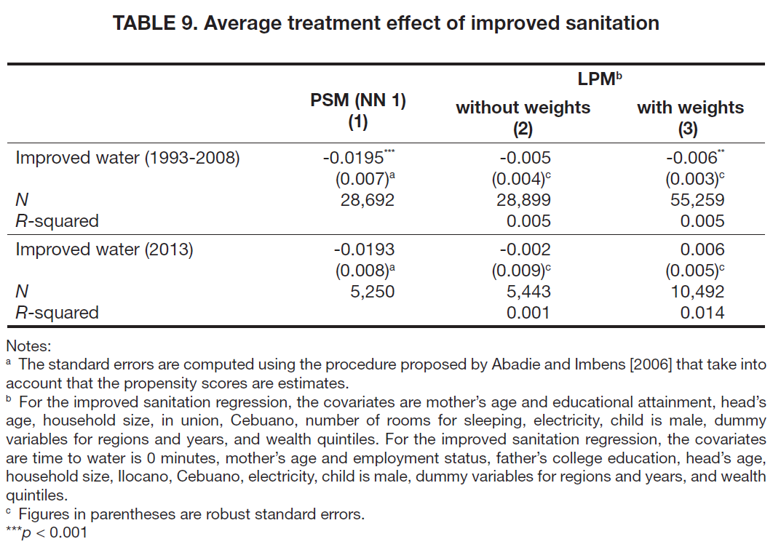
Results

Slide 55
Case Study: Water, sanitation, and hygiene for child health
Capuno, Tan, and Javier (2016)

Slide 56
Finally, we go to our R demo
Sources:
MatchIt: Getting Started (Greifer, 2023) and
Impact Evaluation in Practice (Gertler et al., 2016)

